Slide 1

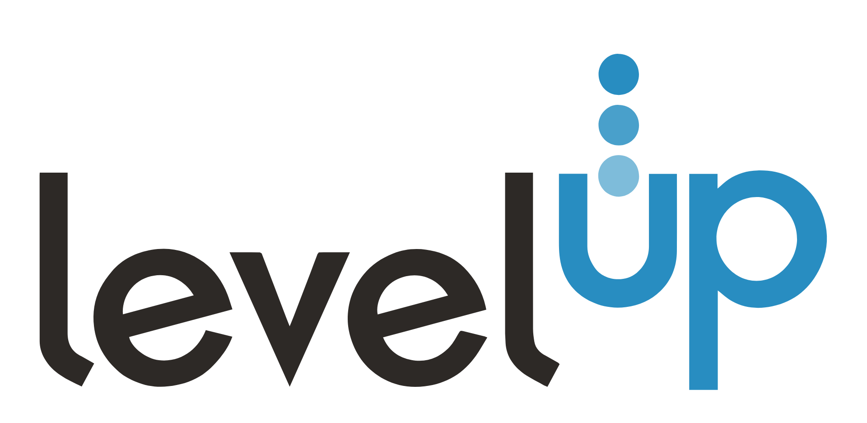

Perks, Programs and
Benefits Guide
Global Benefits
Employee Programs & Benefits
Client Referral Program: Rewarding client referrals with bonuses, globally adjusted. LEARN MORE →
Employee Referral Program: Referral bonuses, globally adjusted. LEARN MORE →
ClassPass: Free monthly credits for employees. *Not currently available in South Africa & Mexico.
Employee Assistance Program (EAP): Free, confidential support for personal challenges. *Not currently available in Hong Kong, India & Mexico.
Birthday PTO: Employees get their birthday day off each year to use on the day of their birthday or the week of.
Volunteer Leave: One day of community service leave for full-time employees, which can be taken in any increment.
Family Support: Employees receive a 3-month diaper subscription to welcome the arrival of their little one.
Technology & Resources
Tech Stack: Features Bullhorn, CloudCall, HireEZ, and LinkedIn best practices.
LevelUP Connection: Provides style guides and templates for consistent communication.
Training & Development
LevelUP Cares: Facilitates societal impact through volunteering and fundraising.
Mentoring Program: Promotes professional and personal growth through mentor connections.
Career Progression Framework: Transparent development structure for career growth at LevelUP.
Recruiter Training Series: Live trainings covering recruitment best practices, sourcing, Boolean logic, and more.
Manager Training Series: Equips managers to support team career progression.

Slide 2



Benefits for Mexican Employees
Health Plan
LevelUP pays 100% of the health plan premium. The overall plan maximum is $1,000,000.
Life Insurance
LevelUP pays 100% of the Life Insurance premium. Employees will receive $50,000 as a one-time lump sum in the event of a death claim.
Work-Life Balance
LevelUP values flexibility and supports a healthy balance between their professional and personal lives.
Hit the Ground Running
New hires go through a unique and comprehensive onboarding program in their first weeks, equipping them for success at LevelUP.
Exposure to World-Class Clients
Our employees are fully embedded within the client’s environment, working on-site to seamlessly integrate with their teams.
This immersive approach enables us to gain deep insights into their processes and ways of working, fostering collaboration and efficiency from within.
LevelUP Your Team Spirit
Employees strengthen bonds and boost collaboration with fun and engaging virtual games.
HR Coffee Chats
The People Team hosts weekly open office hours, providing a safe space for employees to discuss career development and gain support.
For more information, employees should reach out to the People & Culture Team at
hr@leveluphcs.com

